Slide 1
Syed Taimoor Shah
Week 4
CSS

Slide 2
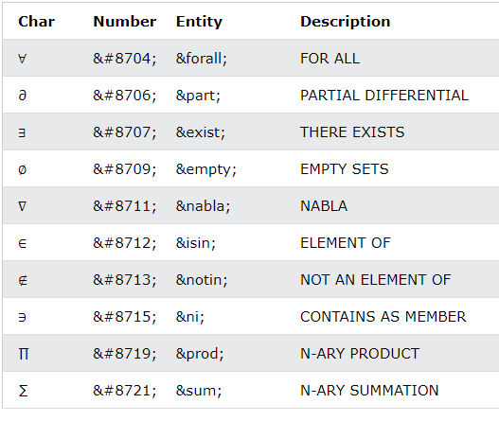
Special Characters
Symbols that are not present on your keyboard can also be added by using entities.

Slide 3
Escape Sequence
&amp creates &
&lt creates <
&gt creates >
&quot creates "
&apos creates '
You can use a character escape to represent any Unicode character in HTML

Slide 4
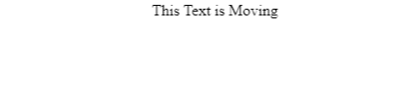
marquee
<marquee> ------ </marquee>
The <marquee> HTML element is used to insert a scrolling area of text. You can control what happens when the text reaches the edges of its content area using its attributes.

Slide 5

Pre
<pre>------</pre>
It is used to display text as it is.

Slide 6
Meta
<meta>-------</meta>
The <meta> tag in HTML provides information about HTML Document or in simple words, it provides important information about a document.It is not visible in the website.

Slide 7
Meta Description
<meta name="description" content=“--------">
The meta description tag in HTML is the 160 character snippet used to summarize a web page's content.

Slide 8
Meta Keywords
<meta name="keywords" content=“---,---,---">
The meta keywords tag is one of several of meta tags that you can insert into your web pages to provide search engines with information about your pages that isn't visible on the page itself.

Slide 9
Meta Author
<meta name="author" content=“-----------">
Author attribute specifies the author of the webpage.

Slide 10
Meta Charset UTF-8
<meta charset="UTF-8">
The charset attribute specifies the character encoding for the HTML document.

Slide 11
Meta Viewport
<meta name="viewport" content="width=device-width, initial-scale=1.0">
Without a viewport meta tag, mobile devices render pages at typical desktop screen widths and then scale the pages down, making them difficult to read.

Slide 12
Meta Refresh
<meta http-equiv="refresh" content="5">
Meta refresh is a method of instructing a web browser to automatically refresh the current web page or frame after a given time interval,

Slide 13

Iframe
<iframe src=“---link---“ height="200" width="300" ></iframe>
The ” iframe ” tag defines a rectangular region within the document in which the browser can display a separate document, including scrollbars and borders.

Slide 14
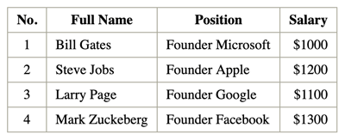
Table
<table> --------</table>
The <table> tag is a block element used to create a table.

Slide 15
Table Tr
<table> <tr>------</tr> </table>
It is used to create a row within a Table.

Slide 16
Table Th
<tr> <th> ------ </th></tr>
It is used to create a Table Heading within the table’s row.
Table head

Slide 17
Table Td
<tr> <td>------ </td> </tr>
It is used to create a colomn of data within the table’s row.
Table data

Slide 18
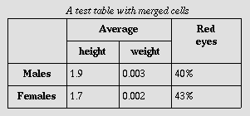
Table Rowspan
<tr> <td rowspan=“2” > ------ </td> </tr>
The rowspan attribute in HTML specifies the number of rows a cell should span.
Rowspan used

Slide 19
Table Colspan
<tr> <td colspan=“2”>------</td> </tr>
The colspan attribute in HTML specifies the number of columns a cell should span.
colspan used

Slide 20
Form
<form>------ </form>
The HTML <form> tag is used for creating a form for user input. A form can contain textfields, checkboxes, radio-buttons and more.

Slide 21
Label
<label for="name"> Name </label>
The <label> tag in HTML is used to provide a usability improvement for mouse users

Slide 22
Input
<input type=“----" id=“----" name=“----" value=“-----">
The <input> HTML element is used to create interactive controls for web-based forms in order to accept data from the user.

Slide 23

Textbox
<input type="text" id=“----" name=“----" value=“-----">
Text input type is used to get data from user in form of text.

Slide 24
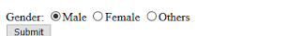
Radio Button
<input type="radio" name=“---" value=“----">"
The HTML <Radio> button is used to define the small circles, which are highlighted when selected. It is a form element which allows the users to select only one option from the given set of options.

Slide 25
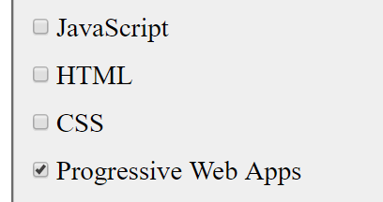
Checkbox
<input type="checkbox" id=“----" name="----" value=“----">
The HTML <checkbox> tag is used to define the square boxes. It is a form element which allows users to select one or more options from the given options.

Slide 26

Drop Down
<select name=“---" id=“---”> <option value="Choose"> Choose </option> </select>
It creates a Drop down list.

Slide 27

Button
<input type=“submit” value=“----”>
It is used to create a Button.

